Slide 1
Chapter 1 What is deep learning?
2026 Fall
조상구교수

Slide 2
Goals
This chapter covers
High-level definitions of fundamental concepts
A soft introduction to the principles behind machine learning
Deep learning’s rising popularity and future potential

Slide 3
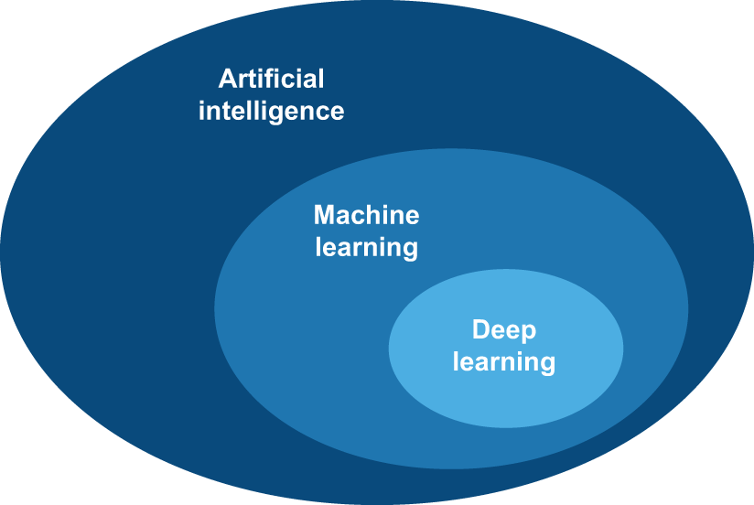
Artificial intelligence, machine learning, and deep learning

Slide 4
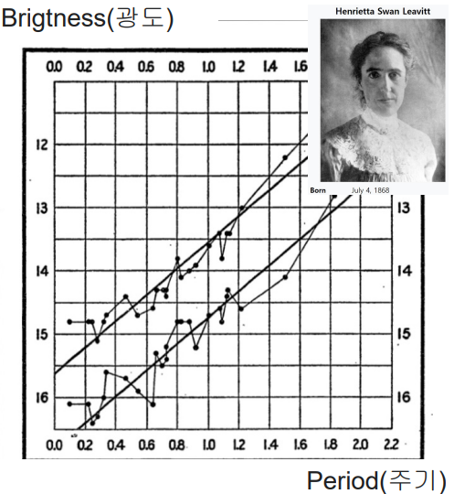
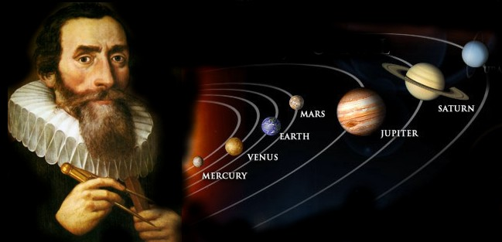
Human Learning
머신러닝이전 시대에는 관측된 데이터에 존재하는 규칙성(Patterns)을 사람이 직접 궁리하고 발견하여 새로운 데이터를 예측 (귀납법)
방대하고 정밀한 데이터들을 직접 수년간 궁리하고 계산(귀납법)한 끝에, 행성이 원이 아닌 '타원 궤도'로 공전한다는 규칙성을 발견
변광성의 밝기가 변하는 '주기'와 실제 별의 '밝기(광도)' 사이에 일정한 선형적 관계(패턴)를 발견

Slide 5

Machine learning
과거 데이터에 존재하는 규칙성(Patterns)을 컴퓨터가 발견하게 하여 새로운 데이터를 예측하는 것이 Machine Learning (New Paradigm)
Rules
Classical
Programming
Answer
Data
Answer
Machine
Learning
Rules
Data

Slide 6
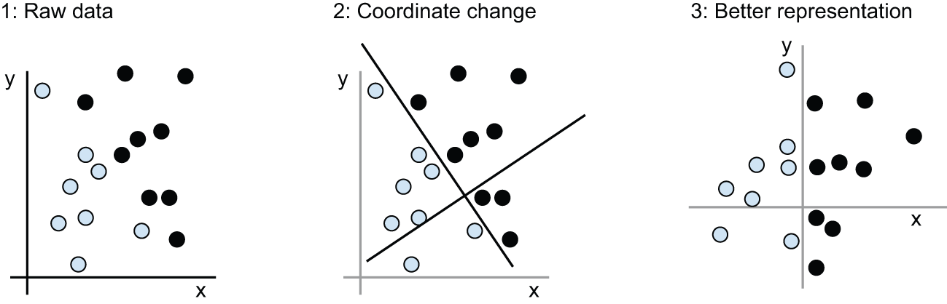
Learning rules and representations from data

Slide 7
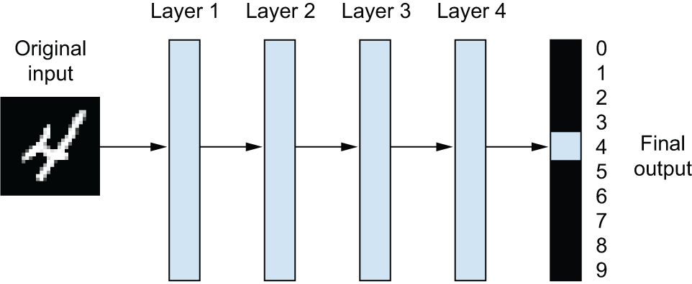
The “deep” in “deep learning”
A deep neural network for digit classification

Slide 8
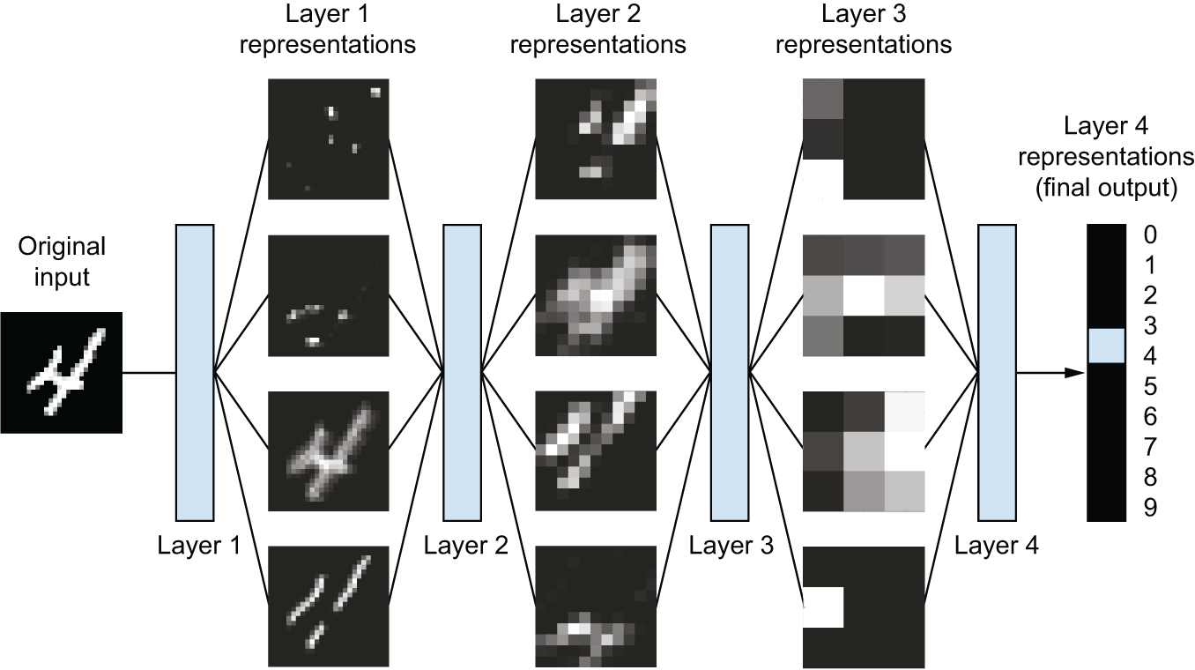
The “deep” in “deep learning”
Deep representations learned by a digit-classification model

Slide 9
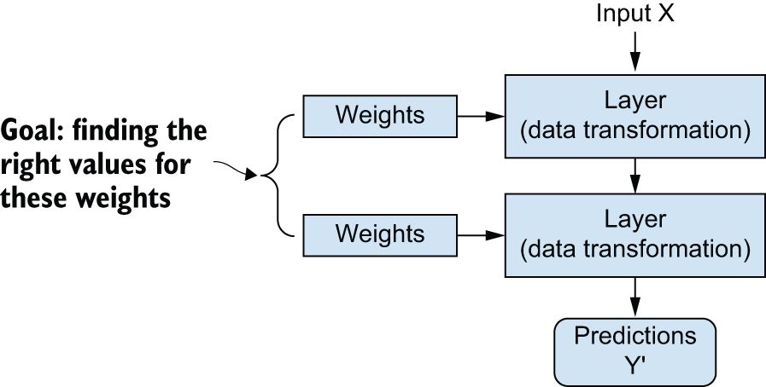
Understanding how deep learning works, in three figures
A neural network is parameterized by its weights.

Slide 10
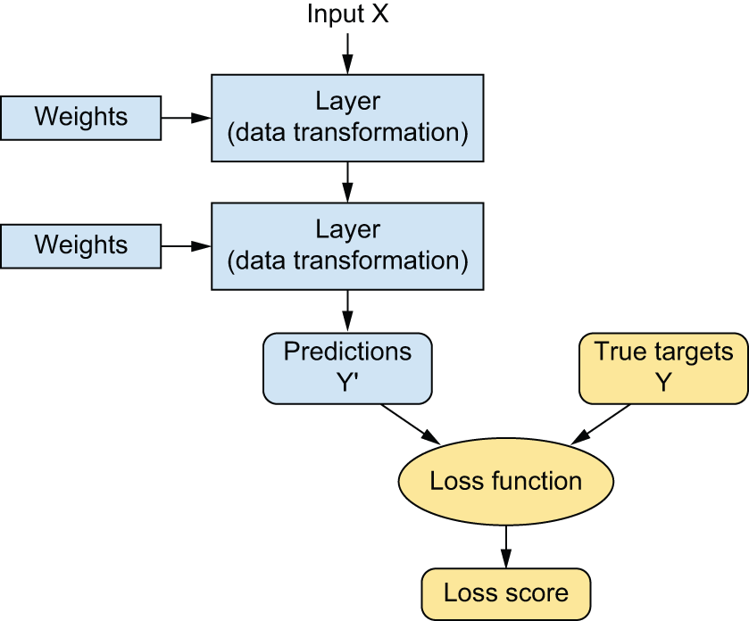
Understanding how deep learning works, in three figures
A loss function measures the quality of the network’s output.

Slide 11
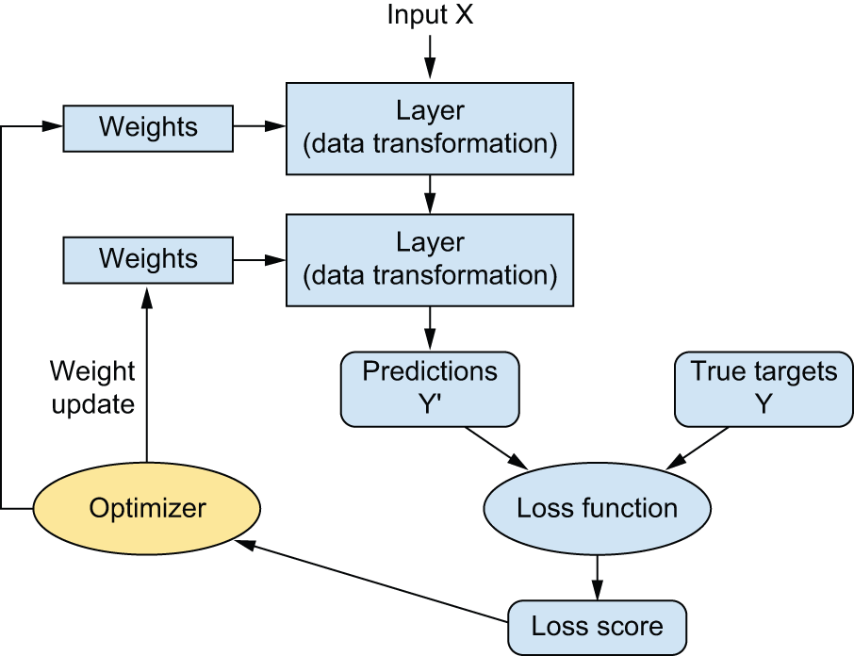
Understanding how deep learning works, in three figures
The loss score is used as a feedback signal to adjust the weights.

Slide 12
What makes deep learning different
Simplicity
To make problem solving much easier, because it automates what used to be the most crucial step in a machine learning workflow: feature engineering.
To completely automate feature engineering step, which has greatly simplified machine learning workflows, often replacing sophisticated multistage pipelines with a single, simple, end-to-end deep learning model.
Scalability
To be highly amenable to parallelization on GPUs or more specialized machine learning hardware
Versatility and reusability
To be trained on additional data without restarting from scratch, making them viable for continuous online learning — an important property for very large production models.
To be repurposable and thus reusable: this is the big idea behind “foundation models” — large models trained on humongous amounts of data, which can be used across many new tasks with little retraining, or even none at all.

Slide 13

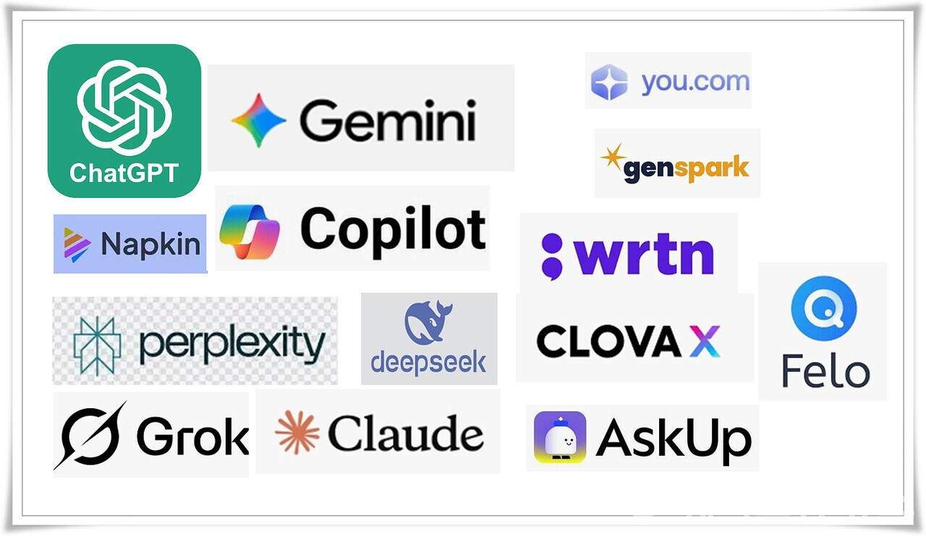
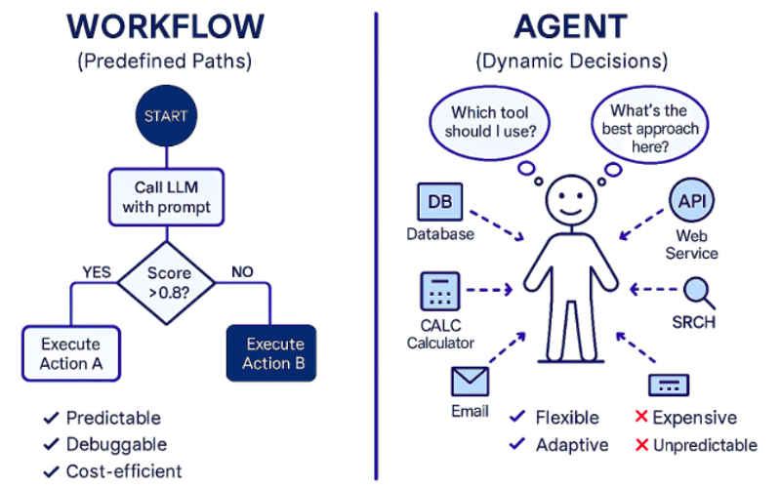
The age of generative AI
2025년 생성형 AI
2026년 AI Agent

Slide 14
Home work
아래 코드로 Keras 실습하고 발표하기
pytorch 기본 코드 및 개념 익히기
Feedforward, Backward, autograd, stochastic gradient descent, optimizer, neuron, layer, loss function
https://github.com/ancestor9/mathematics-for-machine-learning/blob/main/scripts/Introduction_to_deep_learning.ipynb

Slide 15
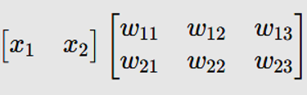
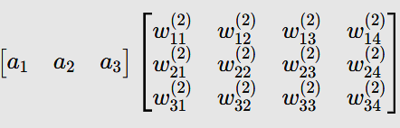
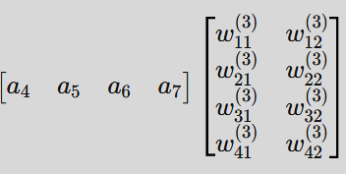
FCCN : Matrix Formulation
Fully Connected Neural Network (FCNN) 구조를 행렬식으로 표현 :
Input(X)
Hidden Layer 1
Hidden Layer 2
Output(y)
(1,2) @ (2,3) = (1,3)
(1,3) @ (3,4) = (1,4)
(1,4) @ (4,2) = (1,2)

Slide 16

Pytorch Hands-on : classification
분류는 입력 데이터가 어느 그룹에 속하는지 판단하는 작업으로 0보다 작으면 0, 0보다 크면 1로 분류(이진 분류 )
# 1. 데이터 생성
X_cls = torch.tensor([[-2.0], [-1.0], [1.0], [2.0]], dtype=torch.float32)
y_cls = torch.tensor([[0.0], [0.0], [1.0], [1.0]], dtype=torch.float32)
# 2. 모델 정의 (Sigmoid를 사용하여 0~1 사이 확률값 출력)
class SimpleClassifier(nn.Module):
def __init__(self):
super().__init__()
self.linear = nn.Linear(1, 1)
self.sigmoid = nn.Sigmoid()
def forward(self, x):
return self.sigmoid(self.linear(x))
model_cls = SimpleClassifier()
# 3. 손실 함수(이진 교차 엔트로피)와 최적화 도구
criterion = nn.BCELoss()
optimizer = optim.SGD(model_cls.parameters(), lr=0.1)
# 4. 학습
for epoch in range(500):
out = model_cls(X_cls)
loss = criterion(out, y_cls)
optimizer.zero_grad()
loss.backward()
optimizer.step()
# 5. 예측
test_neg = torch.tensor([[-5.0]])
test_pos = torch.tensor([[5.0]])
print(f"분류 예측(-5.0): {model_cls(test_neg).item():.4f} (0에 가까움)")
print(f"분류 예측(+5.0): {model_cls(test_pos).item():.4f} (1에 가까움)"

